Slide 1
SGP Precision and Guidance
NEERO Conference
April 25, 2019

Slide 2
Overview of Presentation
Criticism of SGP Accuracy and Reliability
SGP Properties and Uses
SGP Precision for Student-Level Results
Calculation of standard errors
Simulation of standard errors in categorizing student growth
R Square for prediction using SGPs
Use Case: Decision matrix for using SGP results
SGP Precision for Aggregate-Level Results
Calculation of standard errors
Use Case: Local evaluation of district or school programming
Use Case: Quick comparison across schools, districts

Slide 3
SGP Criticism
SGPs are unreliable
Using the same or similar dataset of student results, consistent SGPs are calculated
SGP error is modeled from random and non-random error in testing
There is no validity evidence to support the use of SGPs
Use of SGPs in mode-adjusted studies (MA DESE, in publication)
SGPs violate Standards for Educational and Psychological Testing
Advice encourages descriptive use of SGPs, not intended for generating teacher evaluation results
From: Sireci, S. G., Wells, C. S., & Keller, L. A. (2016). Why we should abandon student growth percentiles.

Slide 4
Student-Level SGPs

Slide 5
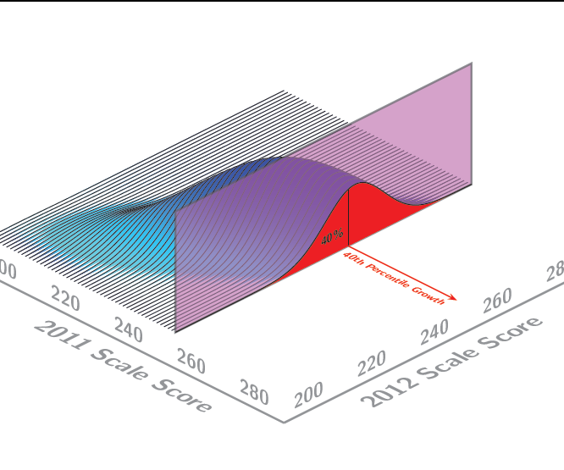
What are SGPs (Student Growth Percentiles?)
Slides and interpretation from Betebenner, D. (October 2013). An Overview of the Student Growth Percentile Methodology. MCAS Technical Assessment Committee Meeting.
Notes:
SGPs provide a norm-referenced interpretation of student growth.
There is a conditional distribution associated with each scale score history:
This is the conditional distribution of students with a 2011 scale score of 256.
Students with a 2012 scale score of 252 have a percentile of 40 on that distribution (SGP=40)
Students with a 2012 scale score of 262 have an SGP of 75.

Slide 6
SGP Computation
Computed using an R routine:
Quantile Regression generates 100 regression lines where students are assigned a SGP from 1 to 99
All students are used in the analysis – there is no “small N” problem regarding cohorts (cohorts are a way to explain the estimation using prior performance, but that is not exactly the way SGPs are calculated)
B-Spline smoothing to provide better fit at the end of the distributions
Distribution of the SGPs is largely uniform with slightly more enrollments in the 1st and 99th quantiles

Slide 7
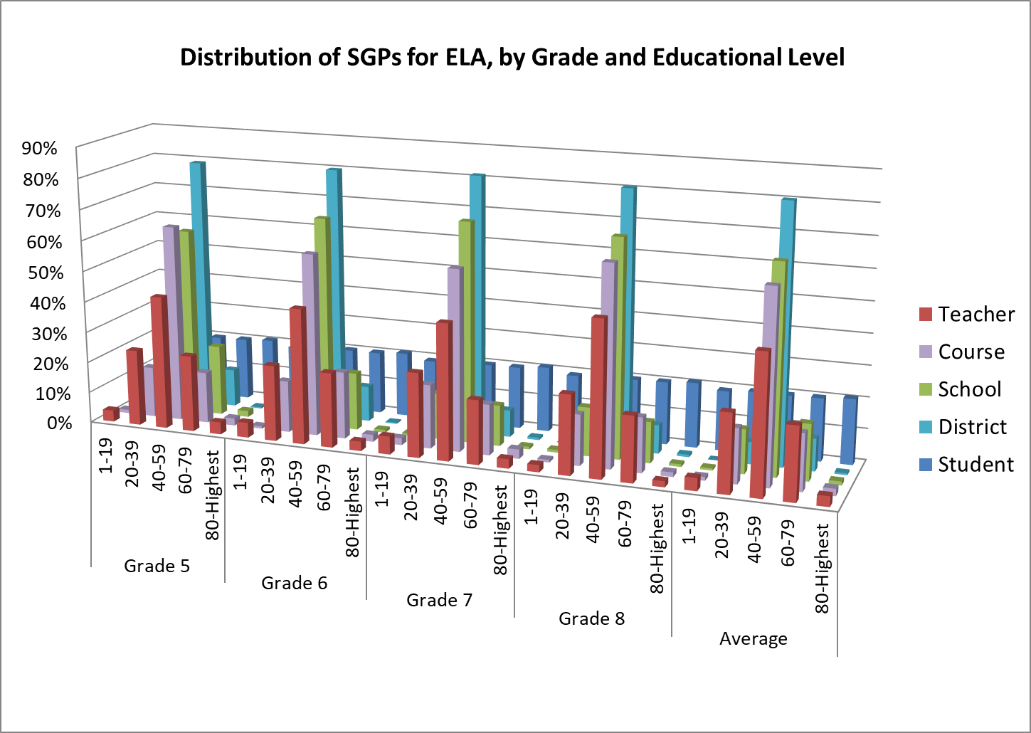
SGP Distributions by Educational Level

Slide 8
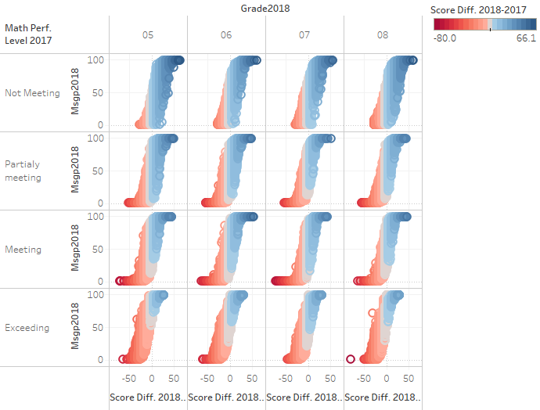
SGPs Model Changes in Student Test Scores

Slide 9
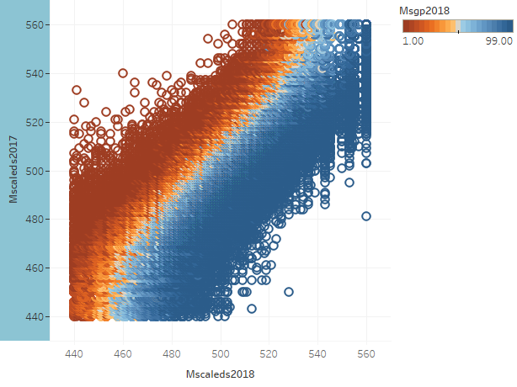
Grades 4-8 combined

Slide 10
Nearly-Equal Opportunity to Grow

Slide 11
Scatterplot Matrix: ELA
Change scores are negatively correlated with prior year’s MCAS SSs (r=-.28 to -.49 )
SGPs are NOT correlated with prior MCAS SSs (r=0), but are positively correlated with current (r=.48 to .57) and future (r=.23 to .25) MCAS SSs
Meaning: Student growth is unrelated to prior achievement levels

Slide 12
SGPs 5X Less Correlated with Student Demographic Variables than Achievement Scores
Notes:
Student-level standard errors for SGPs are generated in the SGP package using an iterative method of applying the conditional standard error of measurement to the students’ current test scores, and generating 100 estimates of the students’ scores. These perturbed scores are used to estimate 100 SGPs. The standard deviation of each set of 100 SGPs is used to identify a unique standard error band for each student.

Slide 13
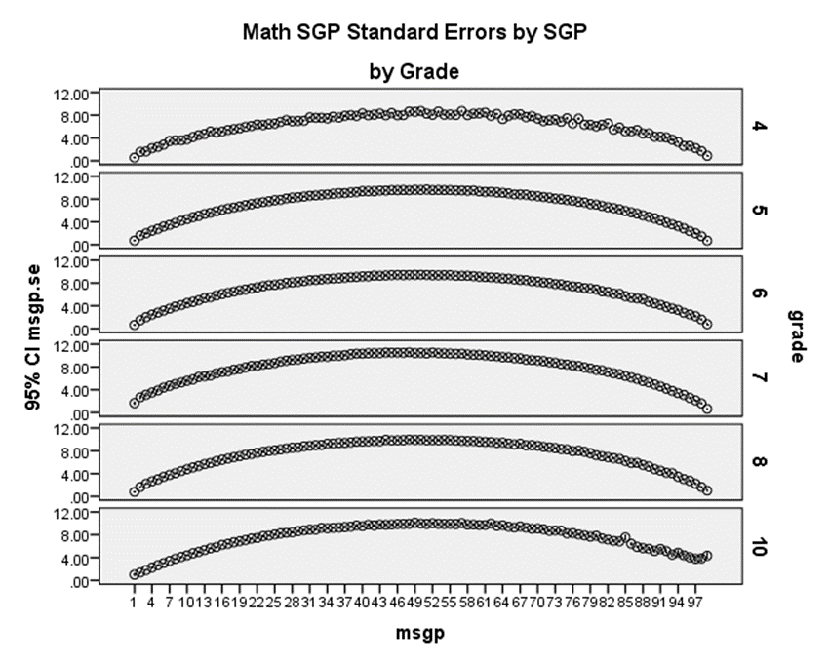
SGP Standard Errors for Students
Average Standard Errors
Average SEs by MSGP
Notes:
Student-level standard errors for SGPs are generated in the SGP package using an iterative method of applying the conditional standard error of measurement to the students’ current test scores, and generating 100 estimates of the students’ scores. These perturbed scores are used to estimate 100 SGPs. The standard deviation of each set of 100 SGPs is used to identify a unique standard error band for each student.

Slide 14
Modeling SGP Error
SGP SEMs are calculated using scaled score CSEMs provided as part of the state’s assessment data used for SGP calculation.
Scale scored CSEMs are used to perturb the observed scales so that 100 simulated SGPs are calculated for each student.
The 100 simulated SGPs are used to calculate a standard error for each SGP reported.
In general, state assessment systems show standard errors for SGPs between 5 and 15.
Notes:
Given average SGP standard errors in 2018 of about 7 points, we can set student-level categories at low, moderate, and high growth using the criteria below. A similar approach can be used to set growth categories for group levels.
Low: 39 or less
Medium: 40 to 60
High: 61 or higher
Using these ranges and the Center for Assessment’s 2016 template for understanding SGP standard errors, we can conclude with 84% certainty that a typical student with an SGP of 32 has an SGP that is below moderate-level growth (Betebenner, DePascale, Marion, Domaleski, & Martineau, 2016). As the Center for Assessment pointed out in their response, guidance materials suggest educators use SGPs in a descriptive manner, such as using them alongside other educational indicators such as baseline results, and using mean SGPs across two or more years. This guidance acknowledges the nonlinear nature of growth for all educational levels (e.g., it can oscillate or display other nonlinear dynamic patterns), and therefore all guidance cautions against overreacting to any one data point.

Slide 15
Modeling SGP Error
SGPs, being percentiles, are uniformly distributed.
However, the distribution of observed SGPs based upon a normal CSEM is normal.
That is, a for a student with a true SGP of 50, observed SGPs occur most often near 50.
For example, a student with an SGP a true SGP of 50, would expect to see an observed SGP of 20 or less 2.5% of the time (assuming an SGP SEM of 15).
Notes:
Given average SGP standard errors in 2018 of about 7 points, we can set student-level categories at low, moderate, and high growth using the criteria below. A similar approach can be used to set growth categories for group levels.
Low: 39 or less
Medium: 40 to 60
High: 61 or higher
Using these ranges and the Center for Assessment’s 2016 template for understanding SGP standard errors, we can conclude with 84% certainty that a typical student with an SGP of 32 has an SGP that is below moderate-level growth (Betebenner, DePascale, Marion, Domaleski, & Martineau, 2016). As the Center for Assessment pointed out in their response, guidance materials suggest educators use SGPs in a descriptive manner, such as using them alongside other educational indicators such as baseline results, and using mean SGPs across two or more years. This guidance acknowledges the nonlinear nature of growth for all educational levels (e.g., it can oscillate or display other nonlinear dynamic patterns), and therefore all guidance cautions against overreacting to any one data point.

Slide 16
Modeling SGP Error
Notes:
Given average SGP standard errors in 2018 of about 7 points, we can set student-level categories at low, moderate, and high growth using the criteria below. A similar approach can be used to set growth categories for group levels.
Low: 39 or less
Medium: 40 to 60
High: 61 or higher
Using these ranges and the Center for Assessment’s 2016 template for understanding SGP standard errors, we can conclude with 84% certainty that a typical student with an SGP of 32 has an SGP that is below moderate-level growth (Betebenner, DePascale, Marion, Domaleski, & Martineau, 2016). As the Center for Assessment pointed out in their response, guidance materials suggest educators use SGPs in a descriptive manner, such as using them alongside other educational indicators such as baseline results, and using mean SGPs across two or more years. This guidance acknowledges the nonlinear nature of growth for all educational levels (e.g., it can oscillate or display other nonlinear dynamic patterns), and therefore all guidance cautions against overreacting to any one data point.

Slide 17
Modeling SGP Error
In situations where students demonstrate low growth (e.g., SGP <= 20), the chances of them having true growth >= 50 (the dividing line for demonstrating a year’s growth) is < 2%.
Because SGPs are uniformly distributed, 20% of students have SGPs <= 20.
Using low SGPs as a flag for investigation of students in possible need of remediation would be justified as those students likely didn’t demonstrate a year’s worth of growth.
Notes:
Given average SGP standard errors in 2018 of about 7 points, we can set student-level categories at low, moderate, and high growth using the criteria below. A similar approach can be used to set growth categories for group levels.
Low: 39 or less
Medium: 40 to 60
High: 61 or higher
Using these ranges and the Center for Assessment’s 2016 template for understanding SGP standard errors, we can conclude with 84% certainty that a typical student with an SGP of 32 has an SGP that is below moderate-level growth (Betebenner, DePascale, Marion, Domaleski, & Martineau, 2016). As the Center for Assessment pointed out in their response, guidance materials suggest educators use SGPs in a descriptive manner, such as using them alongside other educational indicators such as baseline results, and using mean SGPs across two or more years. This guidance acknowledges the nonlinear nature of growth for all educational levels (e.g., it can oscillate or display other nonlinear dynamic patterns), and therefore all guidance cautions against overreacting to any one data point.

Slide 18
Modeling SGP Error
Notes:
Given average SGP standard errors in 2018 of about 7 points, we can set student-level categories at low, moderate, and high growth using the criteria below. A similar approach can be used to set growth categories for group levels.
Low: 39 or less
Medium: 40 to 60
High: 61 or higher
Using these ranges and the Center for Assessment’s 2016 template for understanding SGP standard errors, we can conclude with 84% certainty that a typical student with an SGP of 32 has an SGP that is below moderate-level growth (Betebenner, DePascale, Marion, Domaleski, & Martineau, 2016). As the Center for Assessment pointed out in their response, guidance materials suggest educators use SGPs in a descriptive manner, such as using them alongside other educational indicators such as baseline results, and using mean SGPs across two or more years. This guidance acknowledges the nonlinear nature of growth for all educational levels (e.g., it can oscillate or display other nonlinear dynamic patterns), and therefore all guidance cautions against overreacting to any one data point.

Slide 19
SGPs are Significant Predictors of Student Performance – Two Year Model

Slide 20
SGPs are Significant Predictors of Student Performance – Four Year Model

Slide 21
Use Case: SGP Guidelines by Educational Level and Prior Results
SGPs are used alongside prior or current student results to identify students who may need additional supports.

Slide 22
Aggregated SGPs

Slide 23
SGPs in Aggregations
Properties of SGPs different for student-level and for aggregated levels
SGPs provide key information about student progress
SGPs are much less correlated with student demographic data than achievement scores
At the student level, allow for near-equal opportunity to grow
However, it is important to understand that students are not randomly assigned; consequently, low-growing students are somewhat more likely in certain situations than others

Slide 24
Standard Deviations and Year-to-Year Correlations by Educational Level (From 2014 Paper)
Level | Median | St. Dev. | # Units
Student | 50 | 29 | ~66,000/grade
Teacher | 49 | 17 | ~3000 in elem. And ~1000 in MS
School | 51 | 11 | ~900 in elem. And ~500 in MS
District | 51 | 8 | ~270/grade

Slide 25
SGPs are Significant Predictors of Student Performance at Aggregated levels – Three Year Model

Slide 26


Use Case: Comparing Aggregate SGPs: Comparisons to Schools
Equations:

Slide 27

Use Case: Comparing Aggregate SGPs: Comparisons to State
Equation:
df=n-1
s=29
n=sample n

Slide 28
Considerations in Analyzing SGPs for Aggregated Units
Cross-sectional studies
Multi-year /Time Series Studies
Consider who you are comparing to
Like schools, districts (DART)
Compared to the state (examining gaps, for example)
For a simple aggregate comparisons to the state, consider using a standard error adjusted for N size
Change in growth indicates change in average scores – if an increase is observed see if the school/district can maintain that growth over time (e.g., 60 in year 1, an average of 50 in subsequent years will indicate a positive change in performance that is sustained)
Consider graphing results
Consider using average SGPs over time

Slide 29
Reporting Ideas and Guidelines

Slide 30
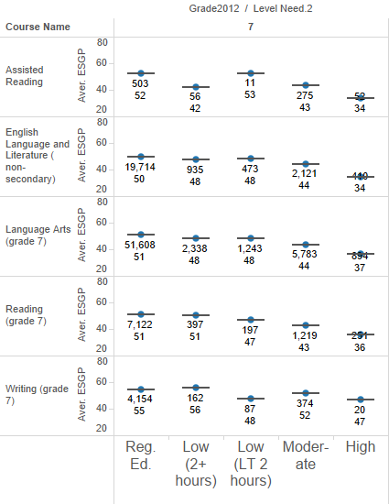
ELA SGP by Prior Achievement with Level of Special Education

Slide 31
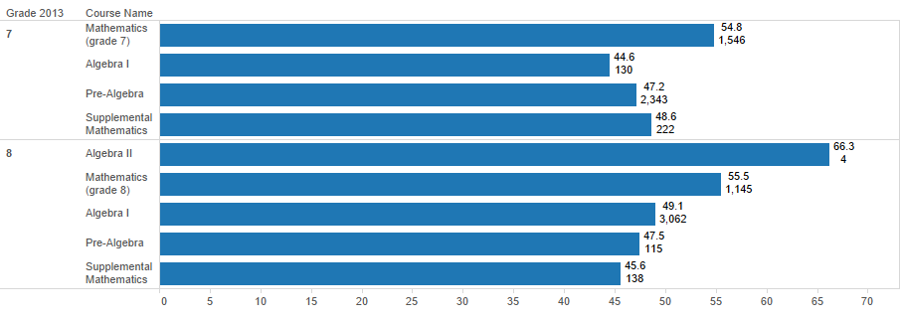
Math SGP by Course

Slide 32
Reporting Recommendations
Use SGP reports to enhance instructional/curricular planning
Report SGPs alongside contextual information (courses, grades, etc.)
SGPs should be reported alongside information on prior (baseline) achievement to enhance appropriate interpretations – if not, use current achievement
Reporting multiple years of SGPs will reduce spurious decisions
At the aggregated levels of reporting, filters may improve the interpretation of SGPs
At the aggregated levels, the range of low, moderate, and high SGPs should be adjusted according to the educational level

Slide 33
References (1)
Betebenner, D. W. (2008). Toward a normative understanding of student growth. In K. E. Ryan & L. A. Shepard (Eds.), The Future of Test-Based Educational Accountability (pp. 155–170). New York: Taylor & Francis.
Betebenner, D. W. (2009). Norm- and criterion-referenced student growth. Educational Measurement: Issues and Practice, 28 (4), 42–51.
Betebenner, D. W. (2012). Growth, standards, and accountability. In G. Cizek (Ed.), Setting Performance Standards: Foundations, methods, and innovations (pp. 439–450). New York: Routledge.
Betebenner, D.W., DePascale, C., Marion, S., Domaleski, C., & Martineau, J. (2016, July 6). Precision, Interpretability & Utility of SGPs: A Response to Why we Should Abandon Student Growth Percentiles by Sireci, Wells, and Keller. Center for Assessment, New Hampshire. Retrieved October 26, 2018, from: https://www.nciea.org/sites/default/files/publications/CFA-Sireci_Response.pdf
Flanagan, K., Lee, R., Kelley, S., & Peoples, S. (April 2014). Examining Evidence of Validity and Utility for the use of Student Growth Percentiles in Massachusetts. New England Educational Research Organization, Vermont.

Slide 34
References (2)
Massachusetts Department of Elementary and Secondary Education (March 2011). MCAS Student Growth Percentiles: Interpretative Guide.
Massachusetts Department of Elementary and Secondary Education (February 2016). Representative Samples and PARCC to MCAS Concordance Studies. Retrieved October 26, 2018, from: https://www.google.com/url?sa=t&rct=j&q=&esrc=s&source=web&cd=1&ved=2ahUKEwiXtPaIqTeAhXBSt8KHUyeBsYQFjAAegQICRAC&url=http%3A%2F%2Fwww.doe.mass.edu%2Fmcas%2F2015%2Fresults%2Fparcc%2FConcordanceStudies.docx&usg=AOvVaw0fiWUfW6d5ujN6NdXHuAC_
Massachusetts Department of Elementary and Secondary Education (In Press). SGP Calculations in 2017: Calculating Transitional SGPs (tSGPs) Using Mode-Adjusted Prior Scores.
Sireci, S. G., Wells, C. S., & Keller, L. A. (2016). Why we should abandon student growth percentiles. (Research Brief No. 16-1). Amherst, MA: Center for Educational Assessment. (Retrieved June 24, 2016 from http://www.umass.edu/remp/news_SGPsResearchBrief.html)

